Slide 1



HOME
BIO
MUSIC
PHOTOS
VIDEOS
STREET TEAM
register
login

Slide 2
Rachel Taylor and Trevor Kelly both worked at Ted Brown Music together in Tacoma, Washington. Aside from the Tacoma aroma (local joke!), there was something else in the air. Trevor thinks it was destiny… Rachel still thinks it was the aroma.
After countless days of passing each other at work, they eventually started to jam together in the back room. While Rachel influenced her past years growing up and Trevor continued to listen to hardcore music, something interesting, creative and original came out. This was the start of He Is We; the idea that someone who you pass by everyday can influence the rest of your life… and you would never know. It’s the thought and power one person can have over their surroundings.
You are listening to Rachel’s words and Trevor’s music. He Is We wants to go on a date with you; the signs are just too obvious.
HOME
BIO
MUSIC
PHOTO
VIDEOS

Slide 3



HOME
BIO
MUSIC
PHOTO
VIDEOS

Slide 4

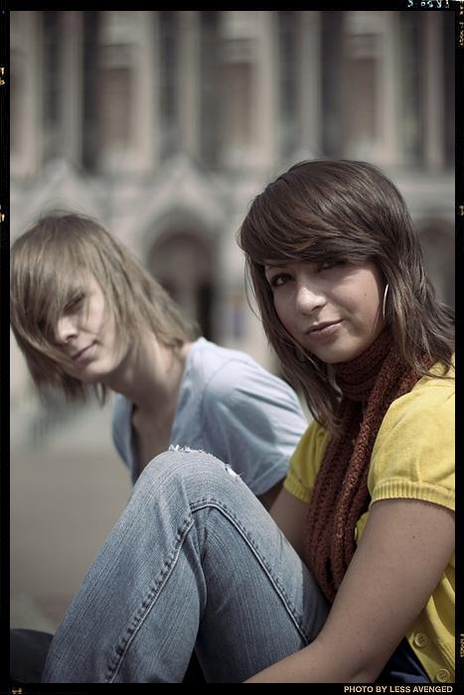

HOME
BIO
MUSIC
PHOTO
VIDEOS

Slide 5
HOME
BIO
MUSIC
PHOTO
VIDEOS

